Slide 1


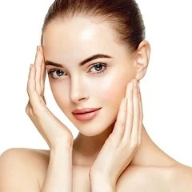
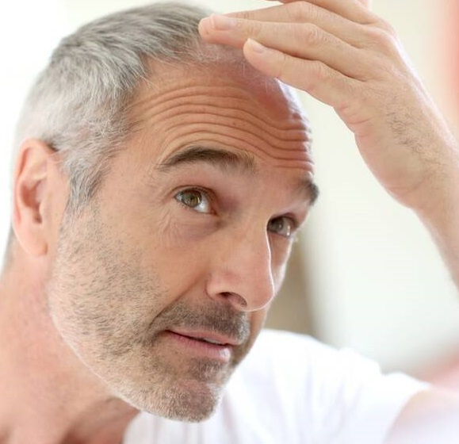
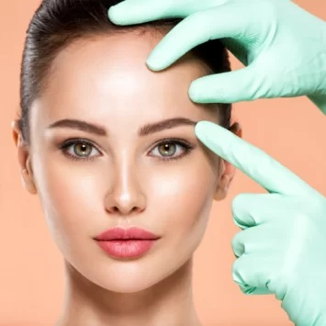
ARSHI SKIN AND HAIR CLINIC
SKIN CARE
HAIR CARE
ANTI AGEING

Slide 2

List of Contents
Executive Summary & Business overview
Organizational Structure
Financials Analysis
Operational Analysis
Strategic Considerations
Awards

Slide 3
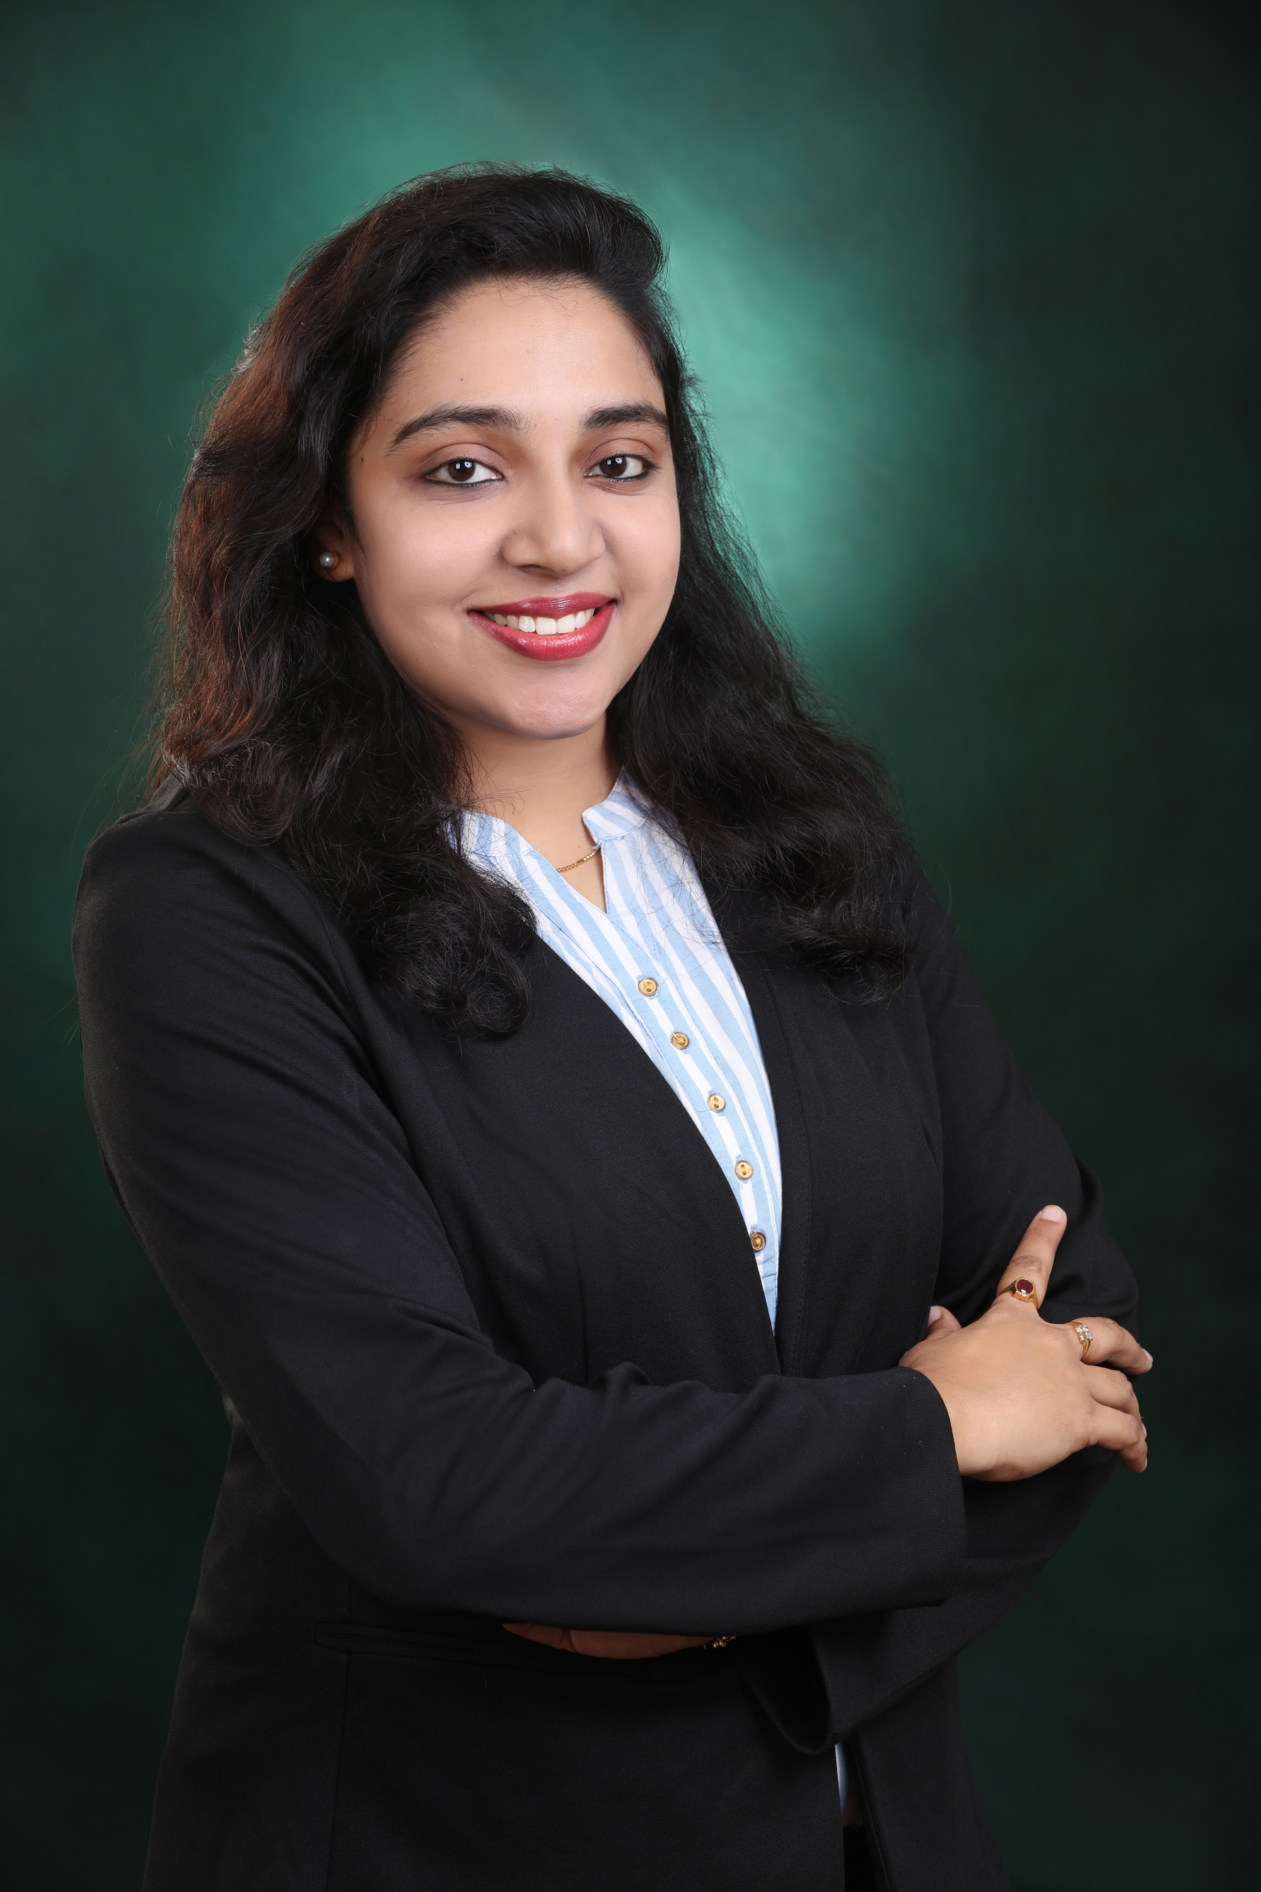
Executive Summary
ARSHI GROUP of skin and hair clinics was started with a vision of providing affordable medical and cosmetic treatments in the field of dermatology to all sections of society.
A team of expert dermatologists, therapists and dedicated staff is led by a visionary Doctor ANNAPURNA TOKALA
DR. Annapurna is one of the few doctors in Hyderabad who got exclusive training in laser science and aesthetic dermatology. She is well known for her compassionate nature and brilliance in academia among her patients, over 14+ years of clinical practice.
Arshi Group of Skin & Hair Clinics we provide wide range of services for restoring natural health of your skin.

Slide 4

Coaching and Mentoring
At Arshi, we believe that our staff is our greatest asset. That's why we're committed to providing ongoing training and development opportunities to ensure they have the skills and knowledge they need to deliver exceptional client services.
At Arshi, we're proud to have a team of highly skilled and well-trained professionals who are dedicated to providing exceptional client services. Our team of dermatologists, aestheticians, and therapists have undergone rigorous training and have extensive experience in their respective fields.
Receive personalized attention and customized treatment plans tailored to your unique needs
Benefit from our commitment to staying up-to-date with the latest industry trends and advancements
Experience the comfort and relaxation of our state-of-the-art facility

Slide 5


Business Overview
Arshi Skin and hair clinic established on 8th March 2017. Arshi Clinic is a reputable provider of skincare and hair restoration services.
Arshi's Visionary Endeavors: Precision in Purpose:
A- To deliver world class quality dermatological services at AFFORDABLE cost for all classes of society.
R- To deliver the best possible RESULTS.
S- To deliver latest treatments with a patient focused approach and render utmost care and compassion in delivering these treatments SAFELY.
H- To have a HOLISTIC APPROACH to both patient and condition to be treated.
I- To INNOVATE and develop new lines of treatment for dermatological and aesthetic conditions.

Slide 6
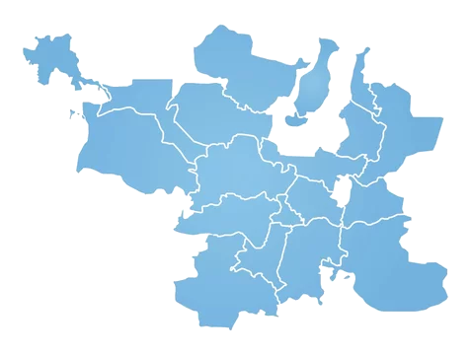
Organizational Structure
Gachibowli
Hitec city
Head Office: 3rd Floor Krishnaveni Arcade, Indira Nagar, Gachibowli, Hyderabad, Telangana 500032
Each branch is equipped with modern facilities and infrastructure to support our team members in delivering exceptional solutions and services, details of branch office as follows
Branch Office -1: Plot 1-99/14, 3rd Floor, Beside Hyderabad Hosts, Madhapur, HITEC City, Hyderabad, Telangana 500081
Branch Office -2: Plot 7-1/2, opposite Bharat Petrol pump, beside Unlimited Shopping Mall, Sri Durga Colony, Madeenaguda, Hyderabad, Telangana 500050
Branch office -3: 3rd Floor, RMK Plaza, Virinchi Circle, Plot 8-2-630 to 636, Hyderabad, Telangana 500034
Hyderabad
Banjara Hills
Madeenaguda

Slide 7
Financial Analysis
38.60%
32.57%
27.45%
20.20%
Adjusted Net Profit

Slide 8
Financial Analysis on turnover
Turnover in Crores
Turnover Analysis over 5 year

Slide 9
Financial growth opportunies
Total revenue and total cost
Particulars | 2024-25 | 2025-26 | 2026-27 | 2027-28 | 2028-29
Gachibowli | 3,29,61,450 | 3,95,53,739 | 4,74,64,487 | 5,69,57,385 | 6,83,48,862
Madinaguda | 74,96,007 | 89,95,208 | 1,07,94,250 | 1,29,53,100 | 1,55,43,720
Banjara Hills | 55,23,950 | 66,28,739 | 79,54,487 | 95,45,385 | 1,14,54,462
Hi-tech city | 53,53,383 | 64,24,059 | 77,08,871 | 92,50,645 | 1,11,00,774
Total Sales | 5,13,34,789 | 6,16,01,746 | 7,39,22,096 | 8,87,06,515 | 10,64,47,818
Closing Stock | 48,92,340 | 53,81,574 | 59,19,731 | 65,11,705 | 71,62,875
Total revenue | 5,62,27,129 | 6,69,83,320 | 7,98,41,827 | 9,52,18,219 | 11,36,10,693
Opening Stock | 28,57,880 | 48,92,340 | 53,81,574 | 59,19,731 | 65,11,705
Purchases | 42,33,454 | 46,56,800 | 51,22,480 | 56,34,728 | 61,98,201
 | 70,91,334 | 95,49,140 | 1,05,04,054 | 1,15,54,459 | 1,27,09,905
Gross Profit | 4,42,43,454 | 5,20,52,607 | 6,34,18,042 | 7,71,52,056 | 9,37,37,913
% Gross profit | 78.69 | 77.71 | 79.43 | 81.03 | 82.51
INDIRECT EXPENSES | 3,91,38,603 | 4,29,41,504 | 4,71,70,006 | 5,18,11,247 | 5,67,49,753
Net Profit | 1,70,88,526 | 2,40,41,816 | 3,26,71,821 | 4,34,06,972 | 5,68,60,939
% Net Profit | 33.29 | 39.03 | 44.20 | 48.93 | 53.42

Slide 10

Financial growth opportunies
Amounts in Crores

Slide 11

Ratio Analysis
Return on Assets
Amounts in Crores
Particulars | 2024-25 | 2025-26 | 2026-27 | 2027-28 | 2028-29
Net Income | 1.71 | 2.40 | 3.27 | 4.34 | 5.69
Net Assets | 3.45 | 3.46 | 3.53 | 3.62 | 4.00
ROA | 0.50 | 0.69 | 0.93 | 1.20 | 1.42
Customer Volume and Growth
Particulars | 2024-25 | 2025-26 | 2026-27 | 2027-28 | 2028-29
Gachibowli | 420 | 504 | 604.8 | 726 | 871
Madinaguda | 210 | 252 | 302.4 | 363 | 435
Banjara Hills | 210 | 252 | 302.4 | 363 | 435
Hi-tech city | 168 | 201.6 | 241.92 | 290 | 348
Total | 1008 | 1210 | 1452 | 1742 | 2090

Slide 12

Ratio Analysis
Return on Investment
Amounts in Crores
Particulars | 2024-25 | 2025-26 | 2026-27 | 2027-28 | 2028-29
Net Profit | 1.71 | 2.40 | 3.27 | 4.34 | 5.69
Cost of investment | 3.49 | 2.43 | 1.46 | 0.88 | 0.53
ROI | 0.49 | 0.99 | 2.24 | 4.96 | 10.82
Liquidity Ratio
Amounts in Crores
Particulars | 2024-25 | 2025-26 | 2026-27 | 2027-28 | 2028-29
Net Assets | 0.92 | 1.01 | 1.22 | 1.36 | 1.70
Current Liabilities | 0.04 | 0.04 | 0.04 | 0.05 | 0.05
Liquidity ratio | 23.49 | 24.30 | 27.82 | 29.34 | 34.88

Slide 13



Operational Analysis
The organization boasts a team of 10 highly skilled Medical Professional and extensively trained dermatologists.
In addition to our medical professionals, each branch is supported by a dedicated team of three auxiliary 22 staff members
Arshi has affiliated sister companies, namely...
Dermacure Pharmaceuticals Private limited
ARSHI
Calin Soft health Care private Limited
US based company having branch office in Hyderabad

Slide 14
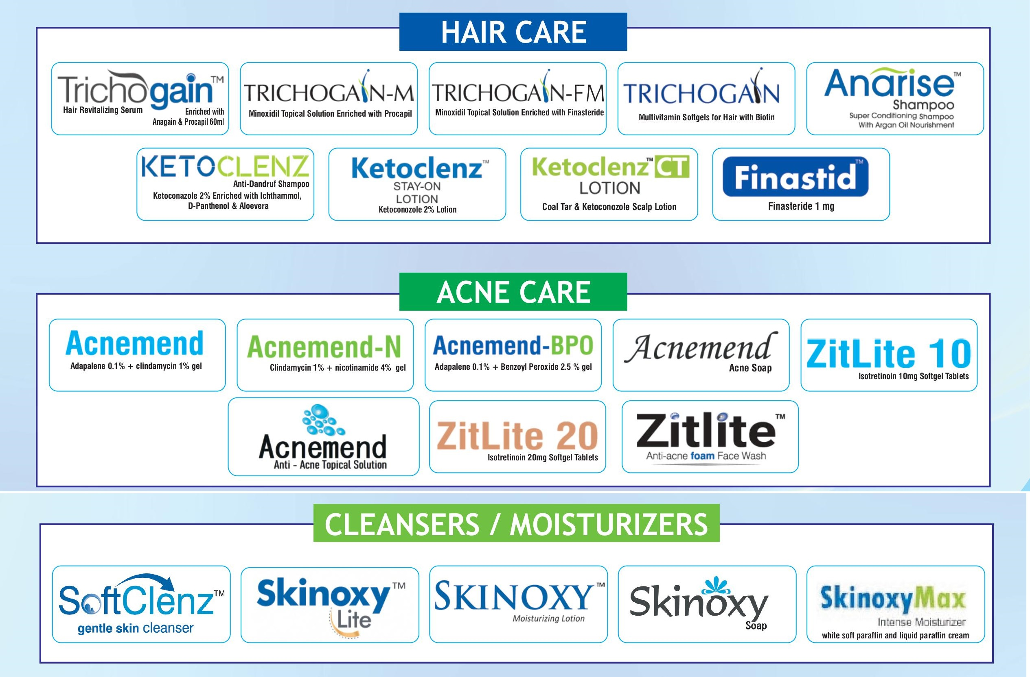
Arshi is the holder of patent rights for 47 products, as outlined in
Annexure-1.

Slide 15
Customer Visit Analysis
Customer visit analysis (on month basis)
Gachibowli branch: 300-350 customers
Madeenaguda branch: 150 -175 customers
Hitech city branch: 125-175 customers
Banjara hills branch: 100-140 customers

Slide 16





Arshi is currently involved in offering the following services:
1. Skin Treatment
2. Hair Treatment
3. Surgical Treatment
4. Anti- Aging Treatments
5. Cosmetic Treatments
6. Children dermatology
Other services and packages details provided in the Annexure-2.

Slide 17
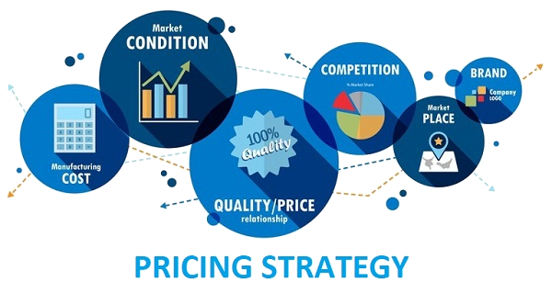


Pricing policy for the respective treatments is detailed in Annexure –3.
To date, the Arshi skin and hair clinic has maintained a pristine record, free from any legal disputes or regulatory risks.
The equipment employed for skin and hair treatments features contemporary technology and advanced infrastructure.
CSR activities are enclosed Annexure –4

Slide 18

Strategic Considerations
Introducing new treatments or services to cater to evolving customer needs and preferences.
Opening additional clinic locations in strategic areas to access new markets and clientele.
Implementing advanced technology solutions for enhanced patient care, such as telemedicine consultations or AI-driven skincare analysis.
Exploring complementary revenue streams such as skincare product sales, beauty services, or wellness programs to diversify income sources.
Developing targeted marketing for attract a broader audience, leveraging social media, influencer partnerships, and digital advertising.

Slide 19
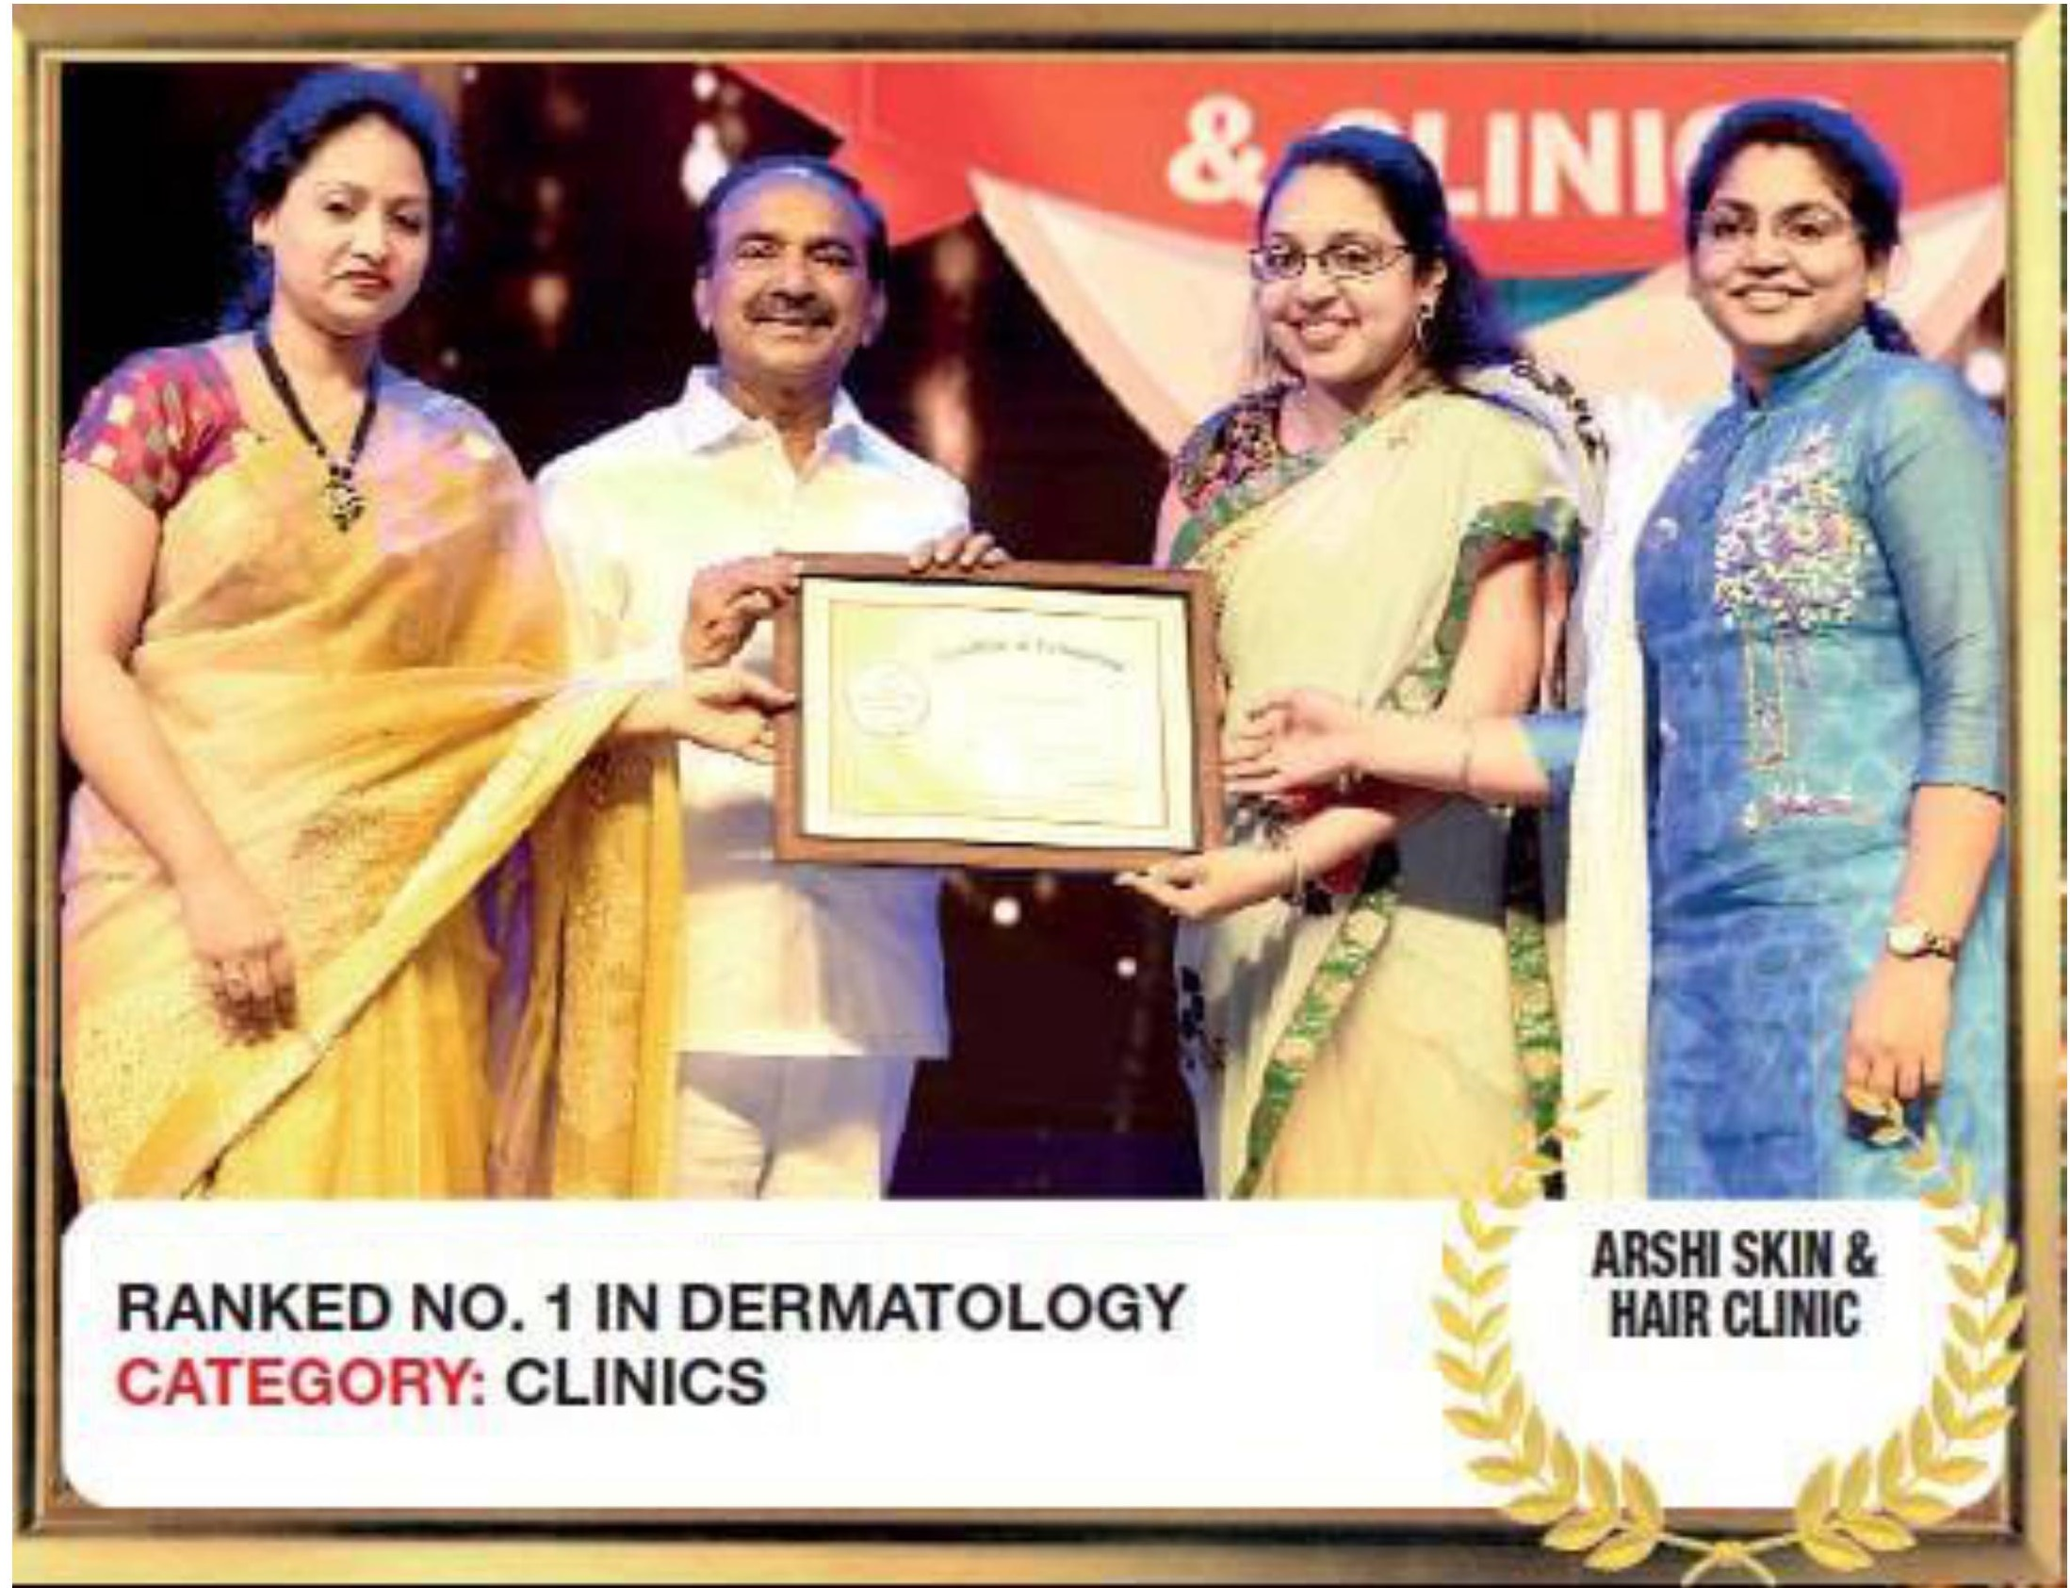
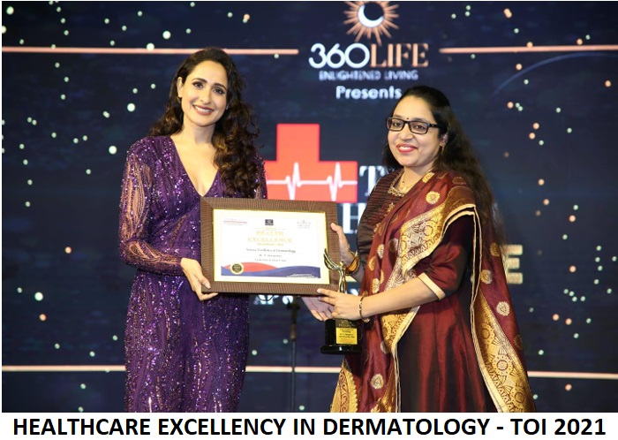
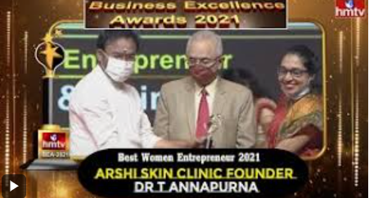
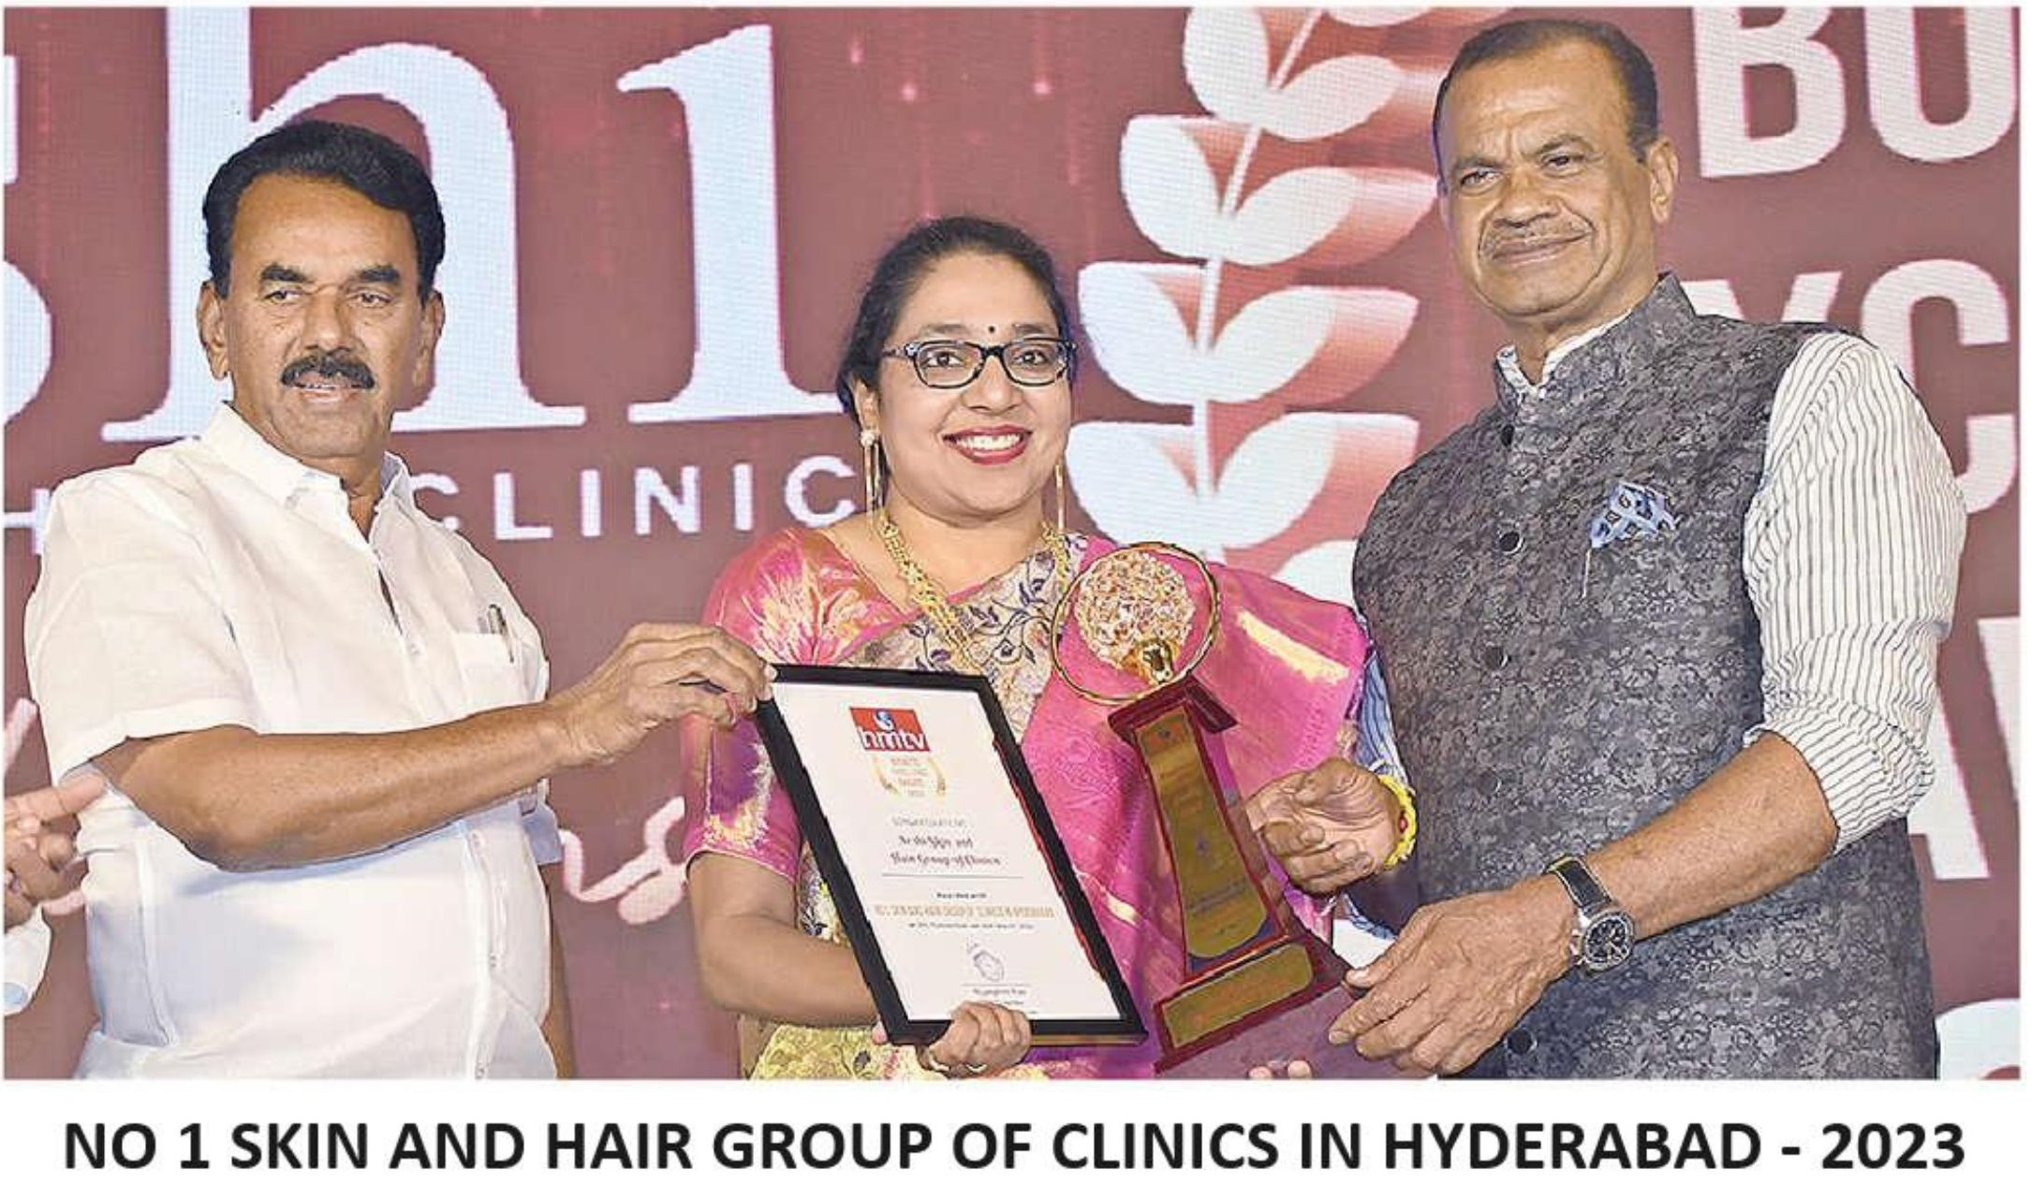
Awards
Arshi is highly esteemed for its expertise in skin and hair treatment, having garnered multiple prestigious awards in recognition of its excellence in the field. these commitment to innovation, quality, and outstanding service in Dermatological and Trichology care.
These awards highlight Arshi’s commitment to excellence and its leading role in the industry.
Telangana Business Excellence Awards 2024.
Ranked No1 Skin & Hair Group of Clinics by HMTV 2023.
Ranked NAARIPURASKHAR by HMTV 2022
Best Women Entrepreneur Of The Year – 2021 by HMTV – ARSHI CLINIC
Ranked No1 In Trichology Award by Times of India – 2019
Other awards as enclosed in annexure –5.

Slide 20


For your interest in

